Slide 1
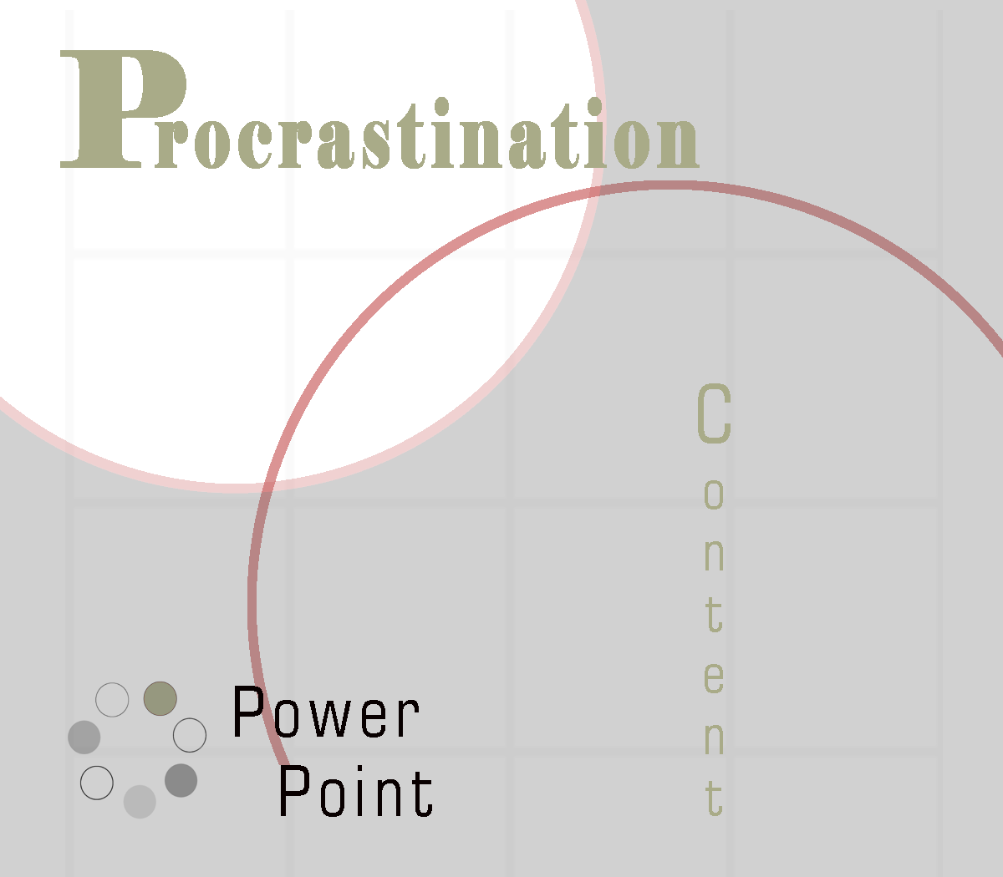
Powerpoint is a registered product of Microsoft. Graphics: Masterclips – IMSI; Art Explosion – Nova Development; Corel

Slide 2

Definition
Letting the low-priority tasks interfere with the completion of high-priority ones.

Slide 3
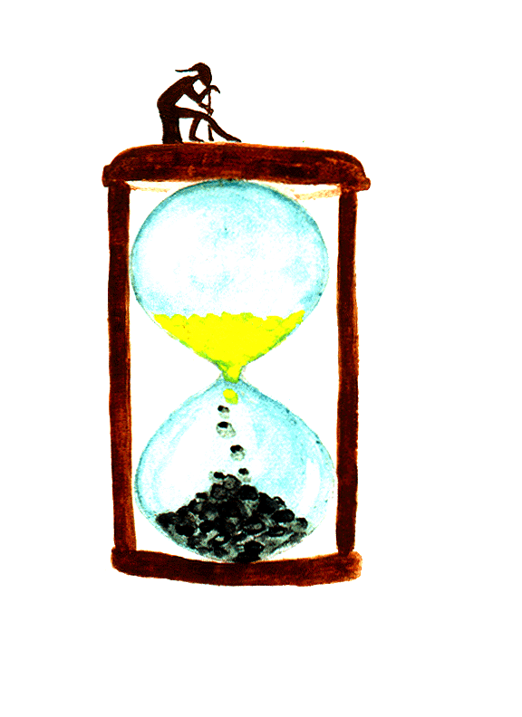
Procrastination Leads To
Wasted Time
Missed Opportunities
Poor Performance
Self-Deprecation
Increased Stress

Slide 4

Overcoming Procrastination
Gives you peace of mind.
Empowers you with strength and purpose.
Allows you to take charge of your life.
Brings you feelings of being strong, capable and confident.

Slide 5

An Insight
Procrastination is reinforcing.
Every time you put off a task, you:
    Avoid a project that could bring you knowledge and success.
    Pass up acquisition of training and skills.
    Establish yourself with failure and fear.

Slide 6

Learning Procrastination
There are three different ways in which procrastination is learned:
The way you think (thoughts, attitudes, emotions).
The way you speak (remarks, conversations, self-talk).
The way you act.

Slide 7


Behavioral Causes (1 of 8)
1. Perfectionism
  Spending more time than allowable.
  Waiting for all resources to be available before acting.

Slide 8


Behavioral Causes (2 of 8)
2. Self-Inadequacies
  Avoiding putting your own skills to a test due to belief of failure.
  Putting a stop to what needs to be done whenever anxiety, uncertainty or discomfort arises.

Slide 9
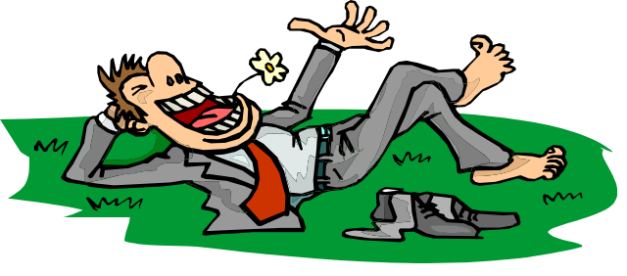
Behavioral Causes (3 of 8)
3. Lack Of Motivation
  The tendency for body at rest to stay at rest. Greater forces are needed to start change than to maintain change.

Slide 10

Behavioral Causes (4 of 8)
4. Lack Of Focus
  The habitual slippage of the mind into a more comfortable presence.

Slide 11
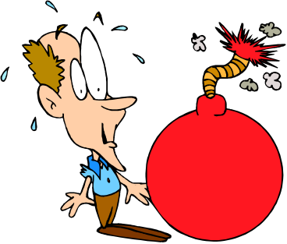
Behavioral Causes (5 of 8)
5. Low Frustration Tolerance
  The tendency to over-focus and magnify tension. Such a person might turn to pleasure-seeking activities as an alternative.

Slide 12

Behavioral Causes (6 of 8)
6. Daydreaming/Fantasizing
  Putting the effects of problem causations in the real world and thus leading to poorly or non-existent developed solutions.

Slide 13
About This Product:
To download this entire Procrastination PowerPoint presentation visit ReadySetPresent.com
Over 100+ slides on topics such as: overcoming procrastination, the 8 causes of procrastination, recognition and signs of procrastination, remedies, approaching procrastinators, 9 rationalizations to avoid, behavioral solutions, do's and don'ts, solving procrastination, 14 remedies for procrastination, the self motivation option, how to's and more. Royalty Free – Use Them Over and Over Again.
Please Visit: www.ReadySetPresent.com

